Slide 1
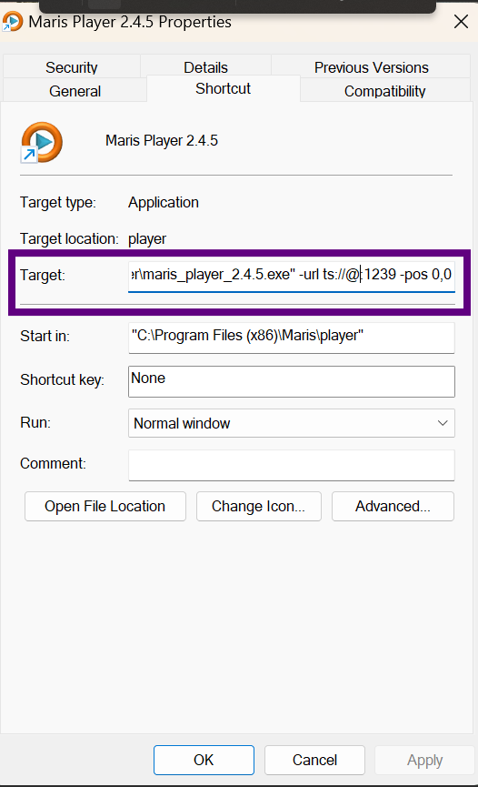
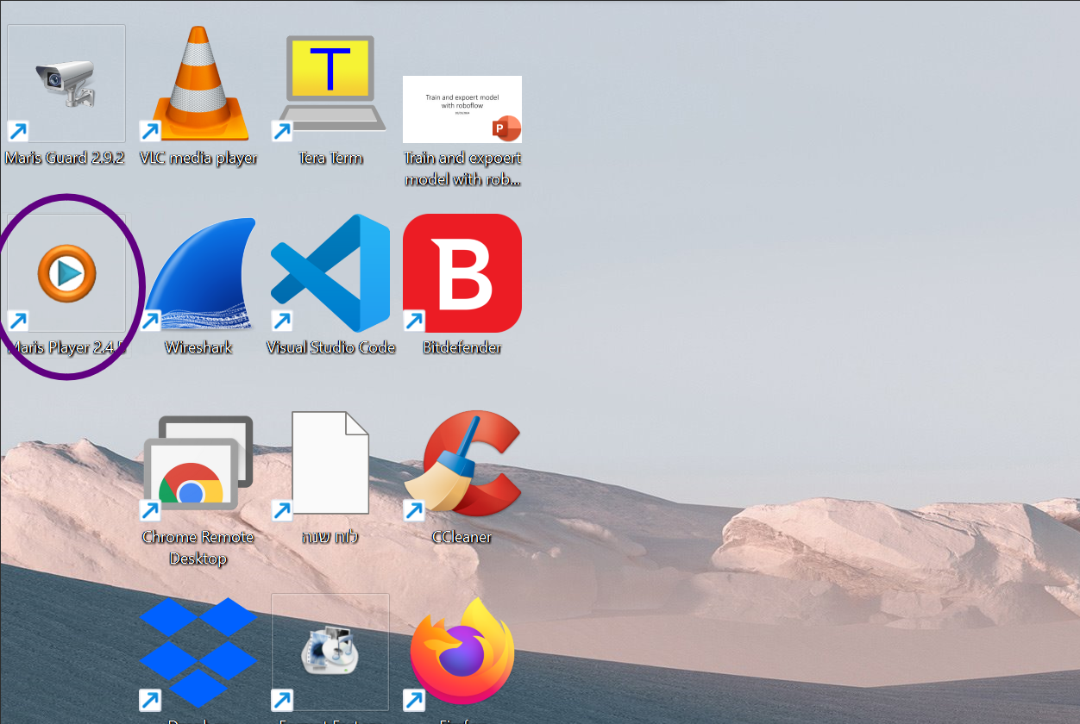
Right-click on the Maris Player desktop shortcut and select "Properties"
Example of parameters:
------- TS --------
-url ts://@:1234
-url ts://@224.0.0.1:1234
-rec d:/records/myfiles.ts
-------- rtsp -------
-url rtsp-udp://@192.168.0.10:554/mux1.sdp
------- *window size -------
-size 500x500
------- *window position (x,y) -------
-pos 20,40
In “Trget” text box, you can add parameters like URL, position, window size, etc..
Need a space between parameters.
*This parameters appears from maris_install_3.7.6 version

